Slide 1

Krizza S. Flores
PSCS Admin Sr. Specialist
Academic Affairs Department

Slide 2
ACADEMIC TERM
2016-2017 2018-2019
1st Semester - Term 1612 1st Semester - Term 1812
2nd Semester - Term 1622 2nd Semester – Term 1822
2017-2018 Annual Term
1st Semester – Term 1712 BAED - Term 1711 (2017-18)
2nd Semester – Term 1722 BAED - Term 1811 (2018-19)
2018-2019
1st Semester – Term 1812
2nd Semester – Term 1822

Slide 3
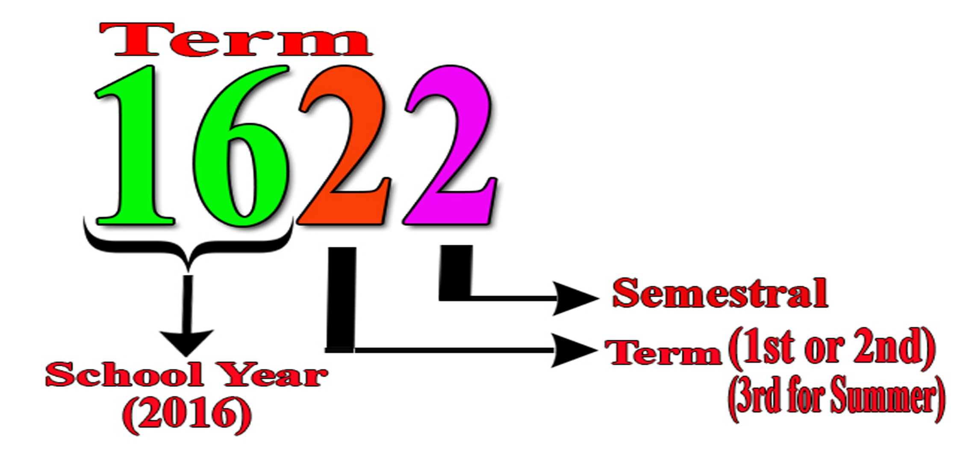
IDENTIFYING ACADEMIC TERM
College & BAED (SHS)

Slide 4
Let’s Practice
1. Academic Term for 2018, 1st Sem, Semestral
1812
2. Academic Term for 2018, Summer, Semestral
1832

Slide 5
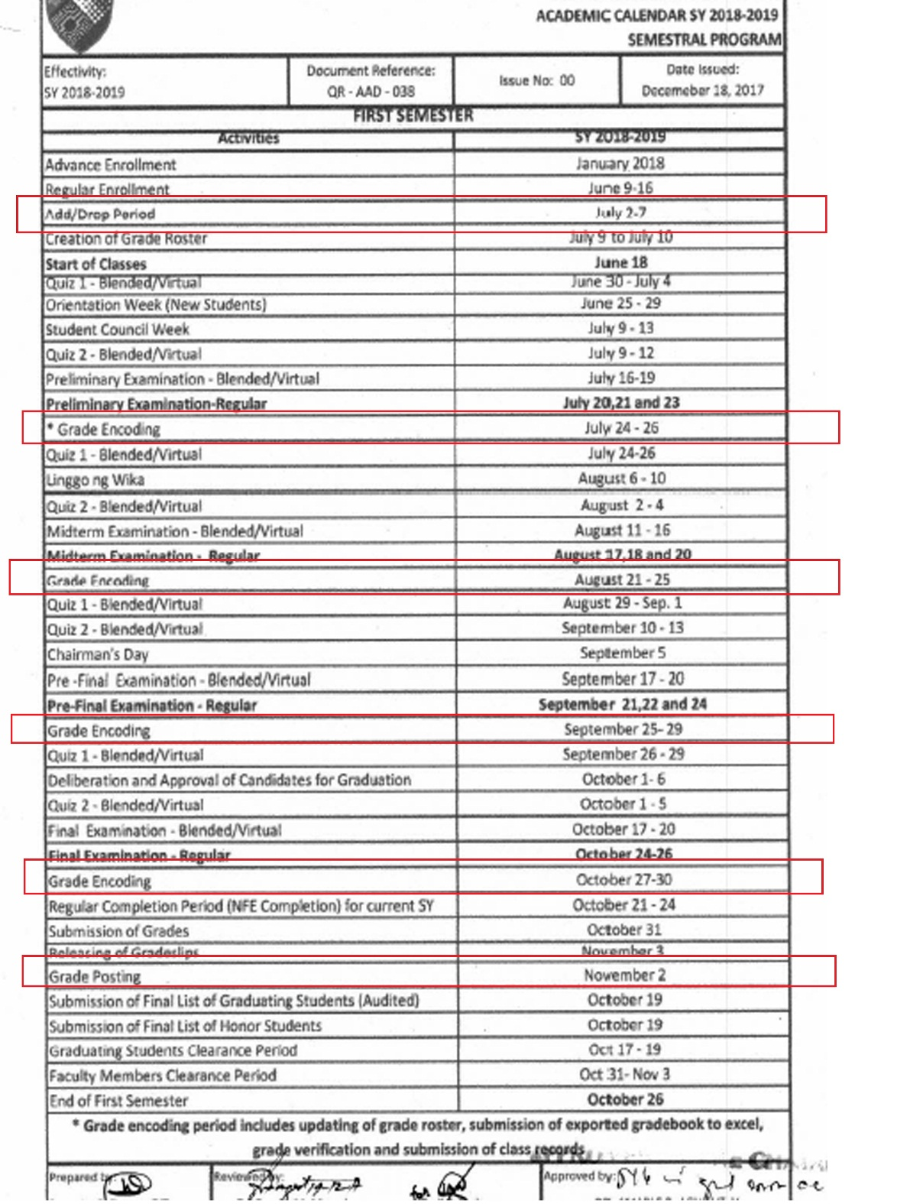
ACADEMIC CALENDAR
Last Day of Enrollment/Enlistment & Add/Drop Period
Grade Encoding – After the Exam
Grade Posting – Before End of the Semester

Slide 6
BRANCH PSCS SYSTEM CODE
BRAND | BRANCH | INSTITUTION | CAMPUS CODE
ACLCC | BUKIDNON | PH008 | CPH04
ACLCC | BUTUAN | PH008 | CPH05
ACLCC | GEN SAN | PH008 | CPH10
ACLCC | MARBEL | PH008 | CPH15
ACLCC | TAGUM | PH008 | CPH24
ACLC | AGUSAN DEL SUR | PH007 | CPH01
ACLC | DAVAO DEL SUR | PH007 | CPH25

Slide 7
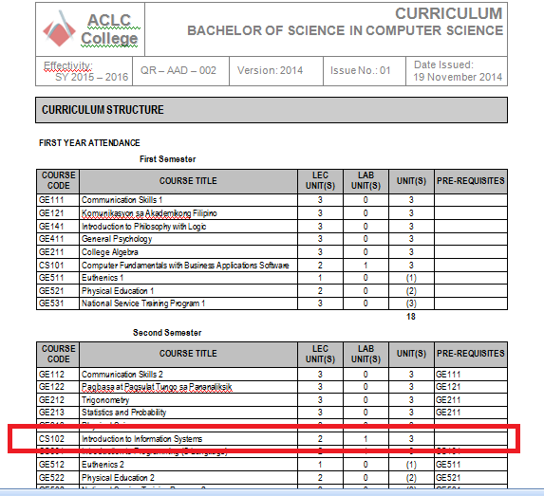

Sample Curriculum:

Slide 8
How to Create Class Schedule

Slide 9
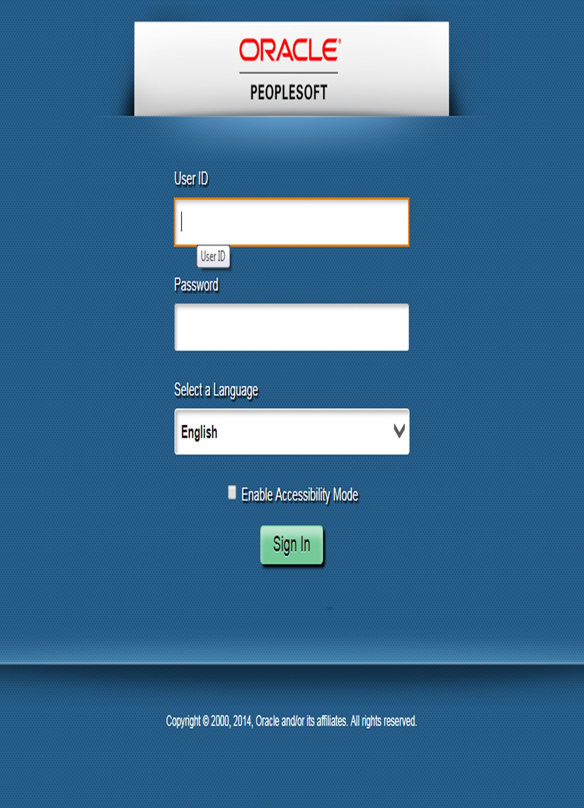
WEBSITE:
LIVE
http://oraclecampus.amaes.com/psp/amacsprd/?cmd=login
For Testing Instance
http://oraclecampus-uat.amaes.com:8020

Slide 10
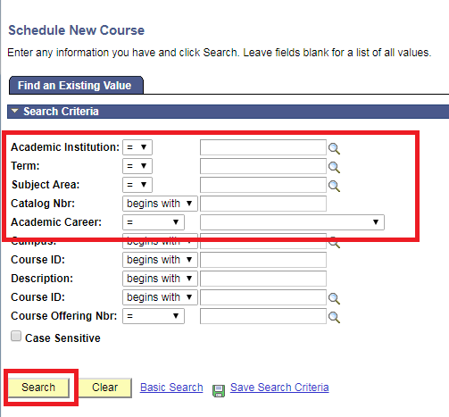
STEP:
1. main menu>> Curriculum Management>> Schedule of Classes>> Schedule New Course)
On the Space Provided
Enter Term
Subject Area
Catalog Nbr
Academic Career
Click Search button

Slide 11
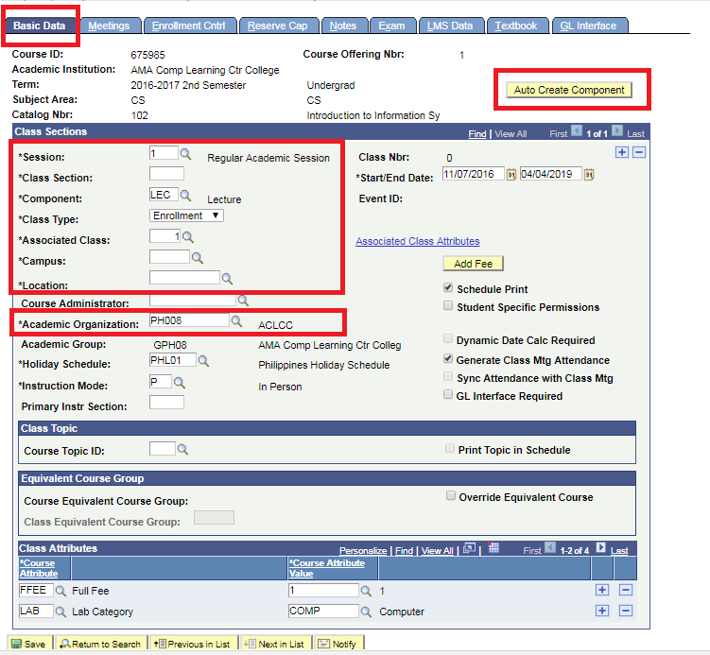
STEP:
2. Enter class section
Make sure that you are on the “Basic Data” Tab
2. Session: 1- Regular Academic Session (Default)
3. Input Class Section
4. Input Component
5. Class Type
6. Campus
Click “Auto Create Component or Click (+) Add Icon” for Lab Component.
In Class Type:
For Lecture, The Class Type is ENROLLMENT
For Laboratory, it is always
NON-ENROLL

Slide 12


Can we create our own class section?
You may create your own class section, Just make sure to use same section but with “ L ” as the last character to specify the lab component of particular lec component

Slide 13
Section names

Slide 14
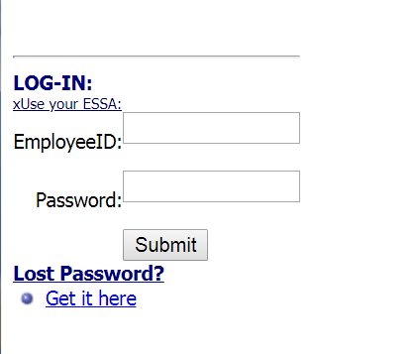
F+ RPT2 (FUNCTION+ REPORT 2)
WEBSITE:
http://usn.amaes.edu.ph/stepreports/alpha.asp

Slide 15
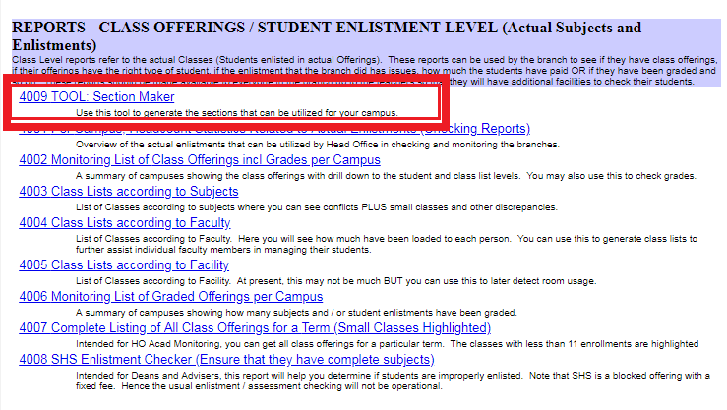

Slide 16
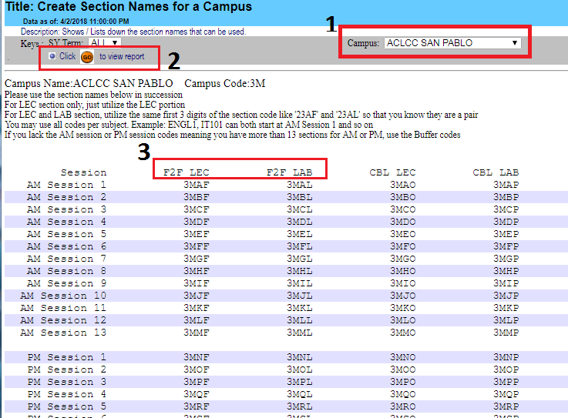

Slide 17
CLASS TYPE: ENROLLMENT
SUBJECT CODE | COURSE TITLE | LEC UNIT | LAB UNIT | TOTAL UNITS
GE411 | General Psychology | 3 | 0 | 3
CS101 | Comp Fund w/ Business App Software | 2 | 1 | 3
SM500 | SM Internship | 0 | 6 | 6
CLASS TYPE: ENROLLMENT
CLASS TYPE: ENROLLMENT & NON ENROLLMENT

Slide 18
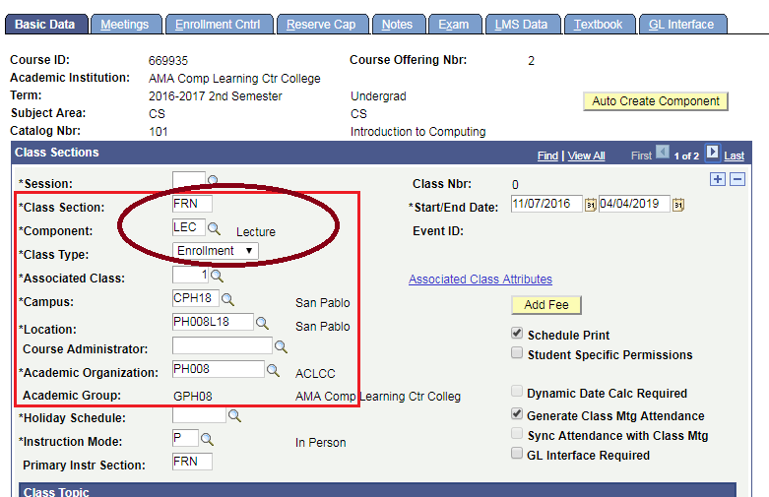
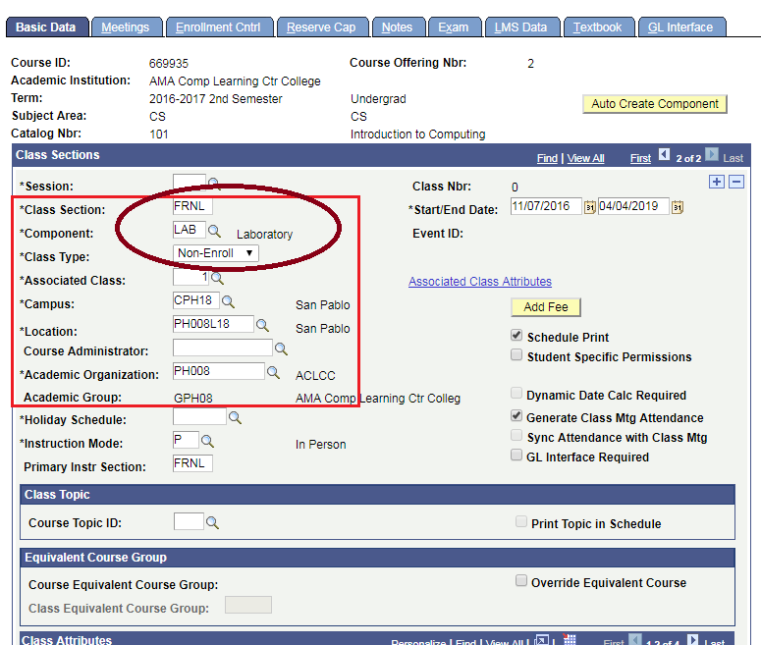
Lec Component Lab Component
Example:
If Class Section FRN is for Lec Component of CS101 the Lab Component section you should create is FRNL

Slide 19
Assign instructor to a class

Slide 20
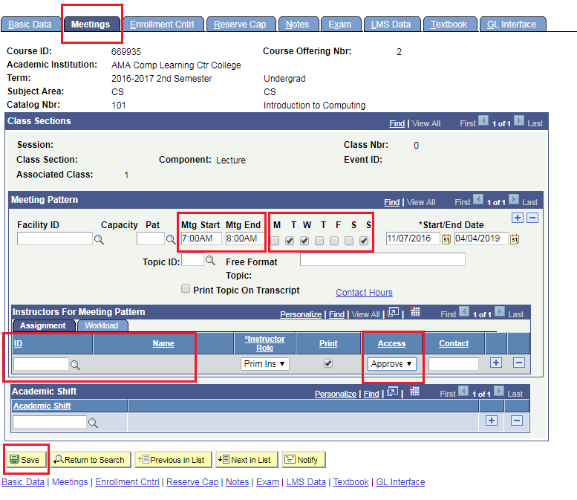

STEP:
3. Meetings tab
Mtg Start, Mtg End and Click appropriate checkboxes for the days.

Slide 21
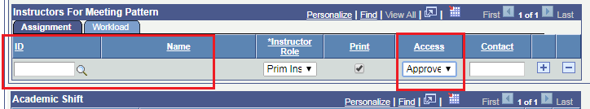
Meetings tab
Search ESSA or EMPLOYEE ID of the assigned faculty.
Choose APPROVE as Access type
* will allow the faculty to post grades of the student.

Slide 22
FACULTY/INSTRUCTOR ACCESS
PSCS Profile Creation Details:
Essa No. :
Last Name, First Name :
Institution-Branch :
Email: ksflores@amaes.edu.ph

Slide 23
PSCS Dean / Acad Coordinator / Principal /SHS Coordinator Access
School Director or Area Director must request approval from our CAO to be granted access
Email: emmagada1@amaiu.edu.bh / emmagada@amaes.edu.ph
Once Approved, Krizza S. Flores ksflores@amaes.edu.ph will process the access
Role:
Essa No. :
Last Name, First Name :
Institution-Branch :

Slide 24
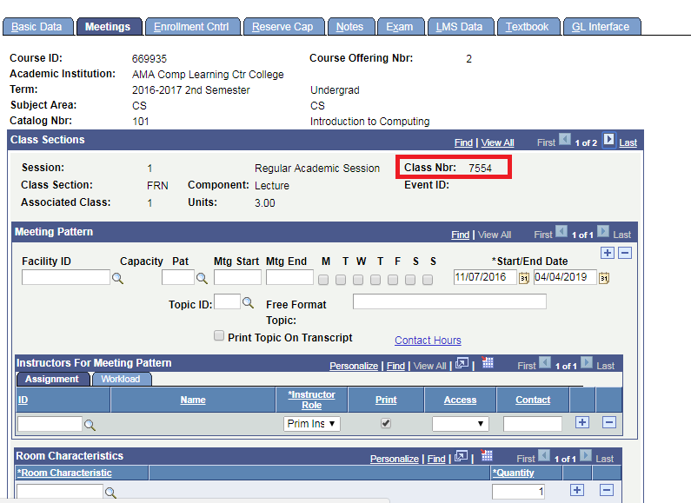
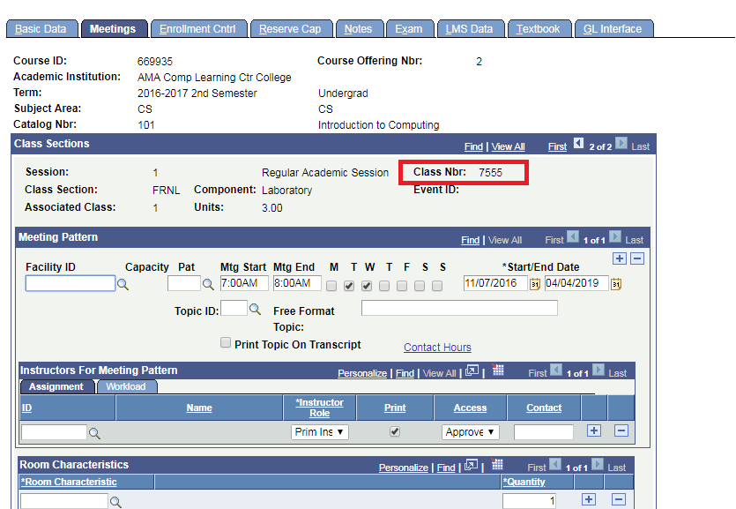
Sample for
LECTURE (CLASS NBR 7554)
LABORATORY (CLASS NBR 7555)

Slide 25
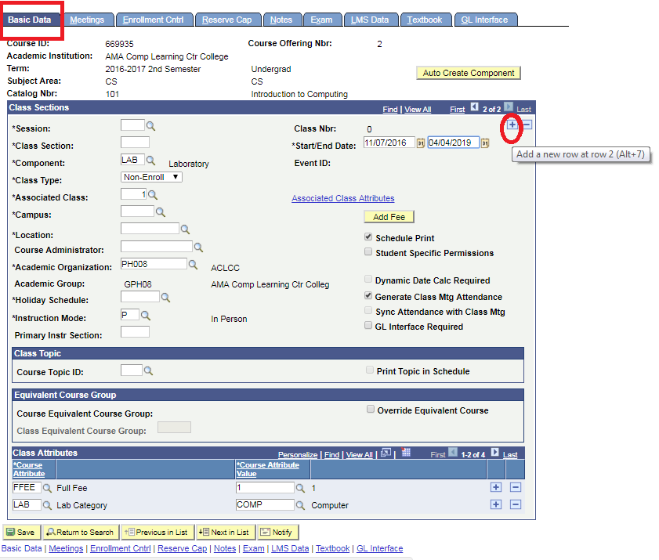
STEP:
4. To add another section
Repeat Step 2 and 3 to create another schedule. Click (+) Button
Step 2 : Enter Class Section (Basic Data Tab)
Step 3 : Meetings Tab

Slide 26
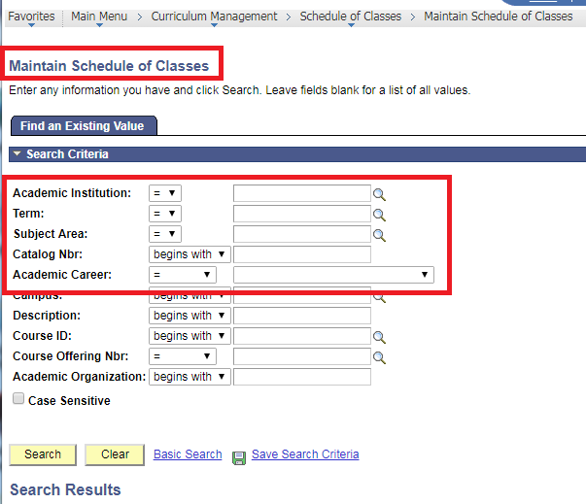

Existing Subject: Main Menu>> Curriculum Management>> Schedule of Classes>> Maintain Schedule of Classes

Slide 27
How to use block name generator

Slide 28
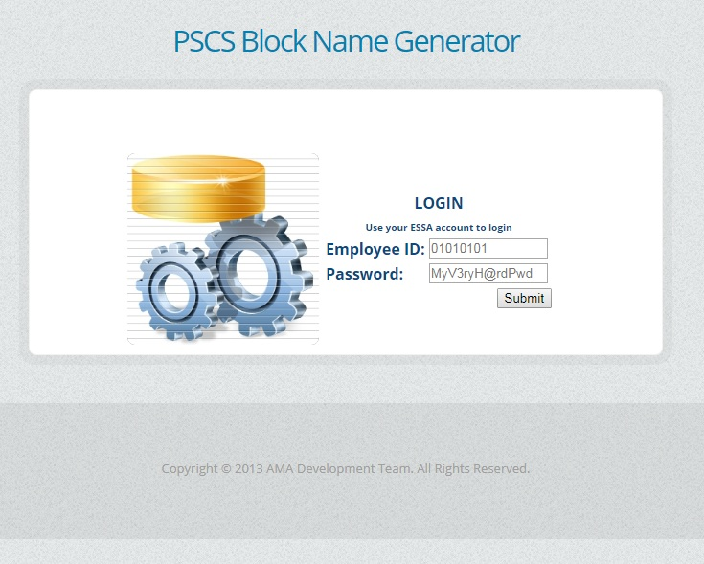
Website:
http://webs4.amaes.edu.ph/PSCSBlockNames/login.asp

Slide 29
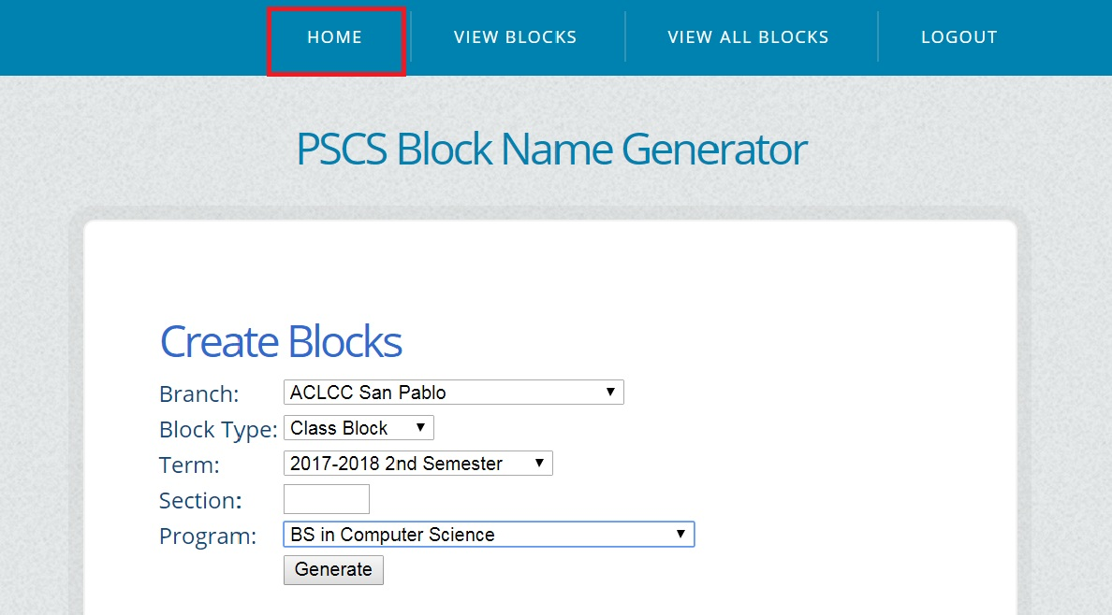
Create Blocks
Block Type: Class Block
Term: Choose the term to create the block
Section: Enter Block Section
Program: Specific Program for the block
Click the generate button

Slide 30
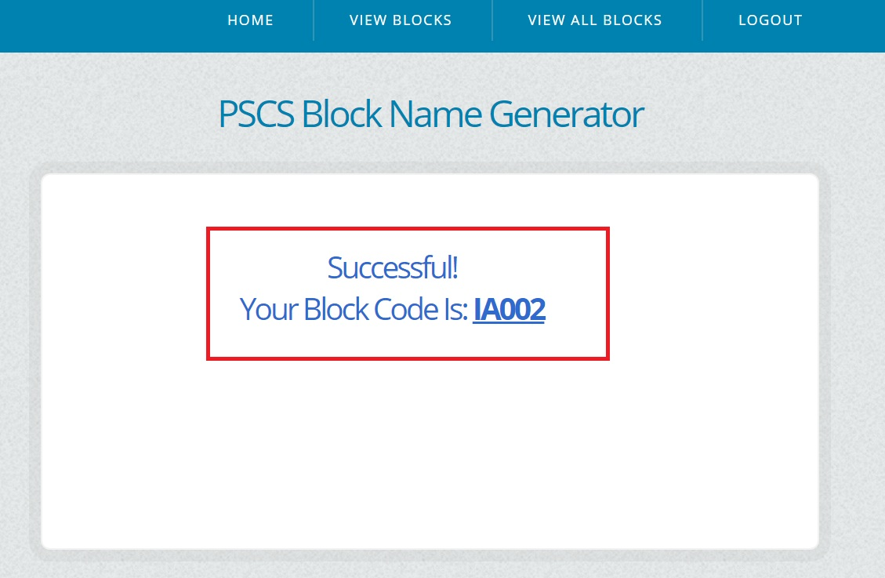
After a successful generation, a code will be given. Use this code when creating blocks.

Slide 31
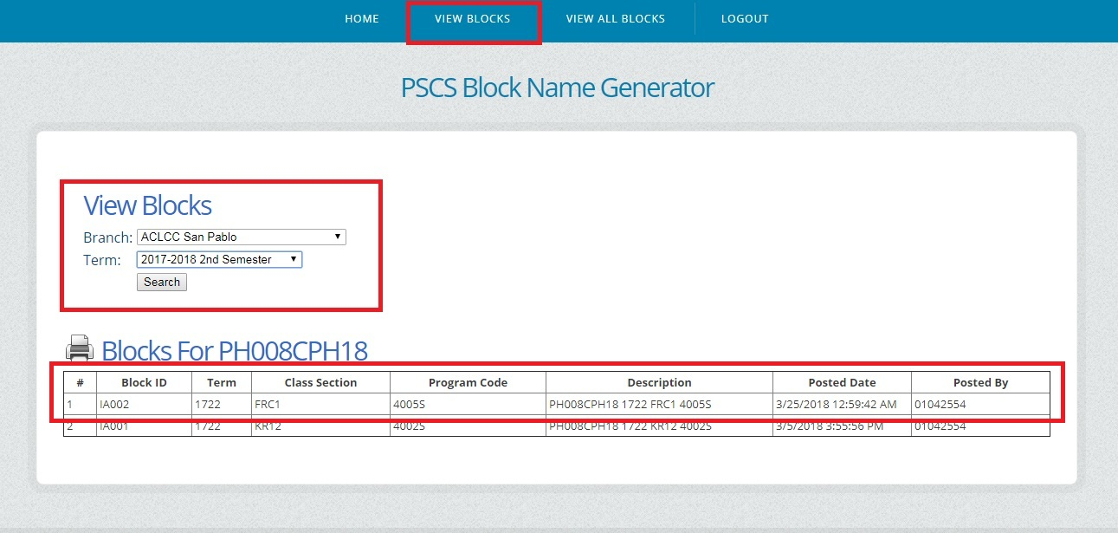

Slide 32
Creating class block

Slide 33
WEBSITE:
LIVE
http://oraclecampus.amaes.com/psp/amacsprd/?cmd=login
For Testing Instance
http://oraclecampus-uat.amaes.com:8020

Slide 34
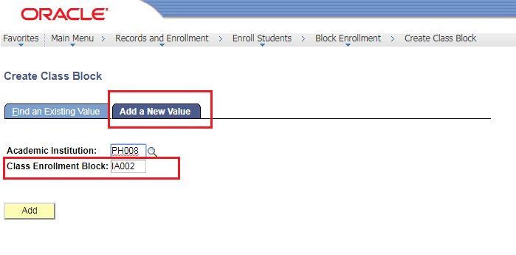
MAIN MENU>> Record & Enrollment >> Enroll Student >> BLOCK ENROLLMENT >> Create Class Block
Note: Use PSCS Block Name Generator for the Class Enrollment BLOCK CODE and DESCRIPTION.

Slide 35
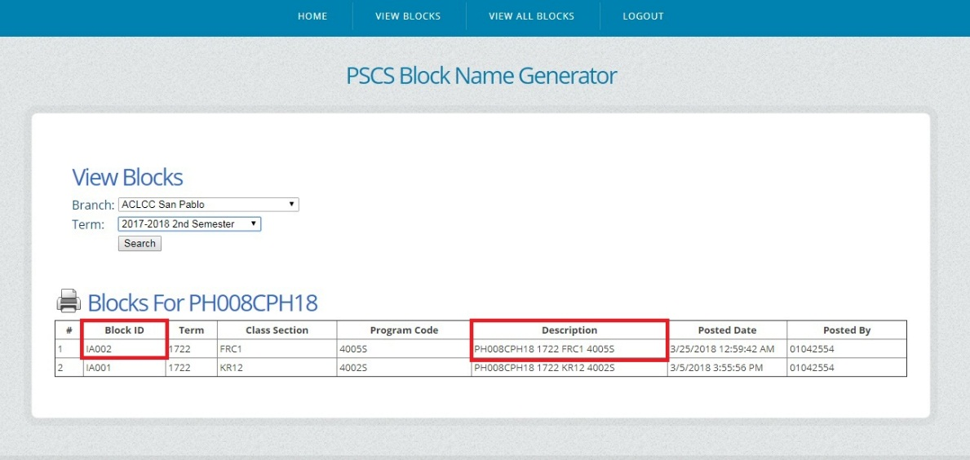
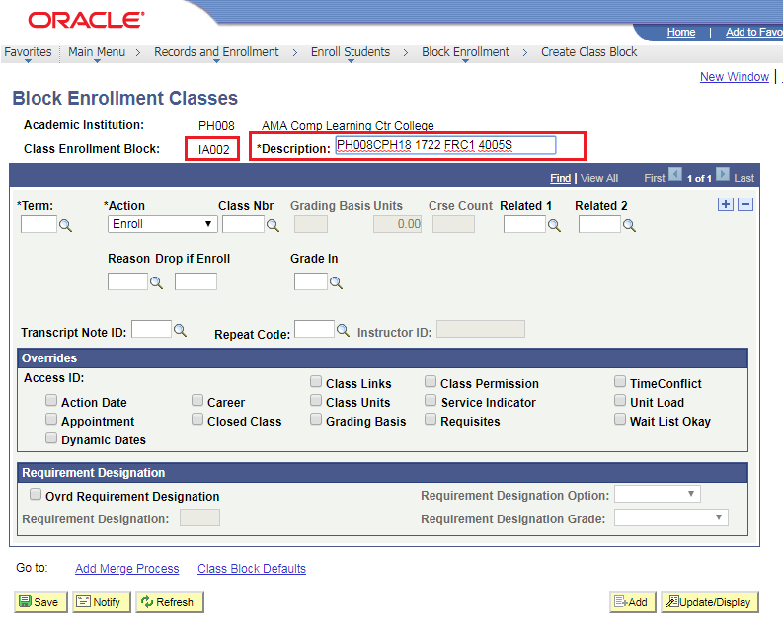

Slide 36
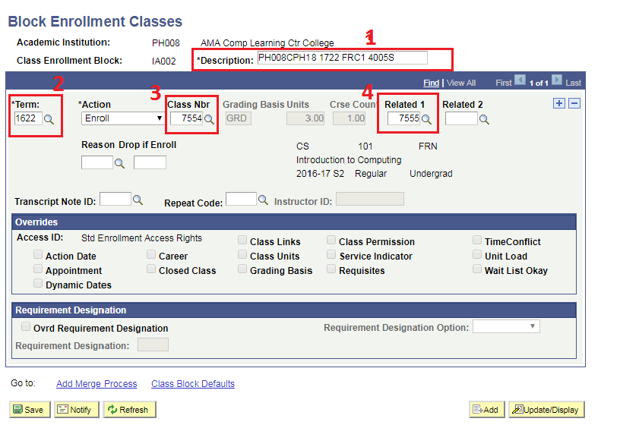
1. Description
2. Term
3. Class Nbr (Lec)
4. Related 1 /Class Nbr (Lab)

Slide 37
CREATING STUDENT BLOCK

Slide 38
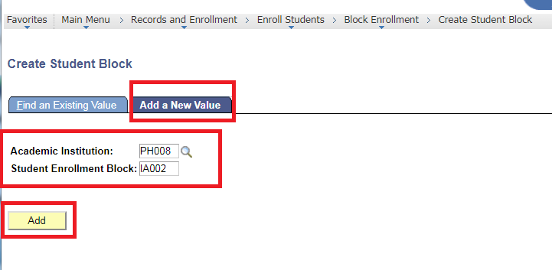
MAIN MENU>> Record & Enrollment >> Enroll Student >> Block ENROLLMENT>> CREATE STUDENT BLOCK
Note: Use PSCS Block Name Generator for the Student Enrollment BLOCK CODE and DESCRIPTION.

Slide 39
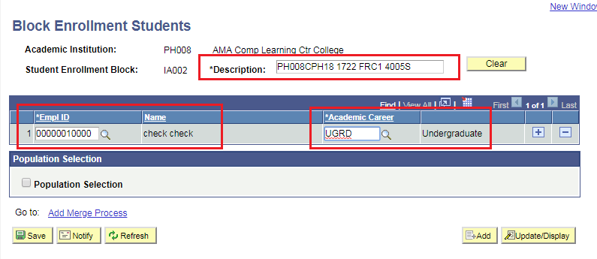
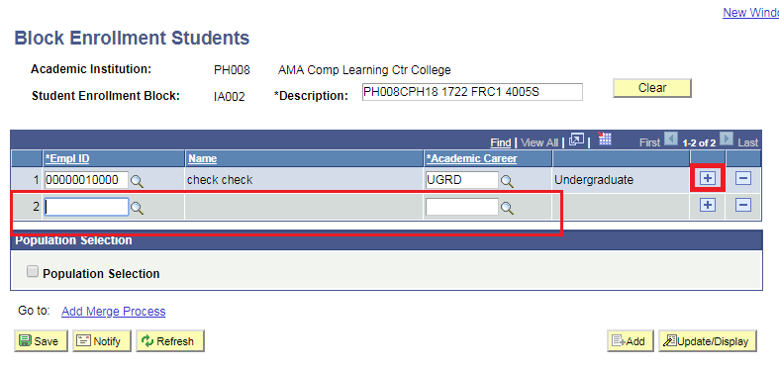
USN/ID of the Student

Slide 40
CLASS BLOCK (classes)
STUDENT BLOCK
(name student)
BLOCK ENROLL MERGE

Slide 41
Block enroll merge

Slide 42
Make sure that CLASS BLOCK was already created by DEAN.
Make sure that STUDENT BLOCK was already created by ADMISSION.

Slide 43
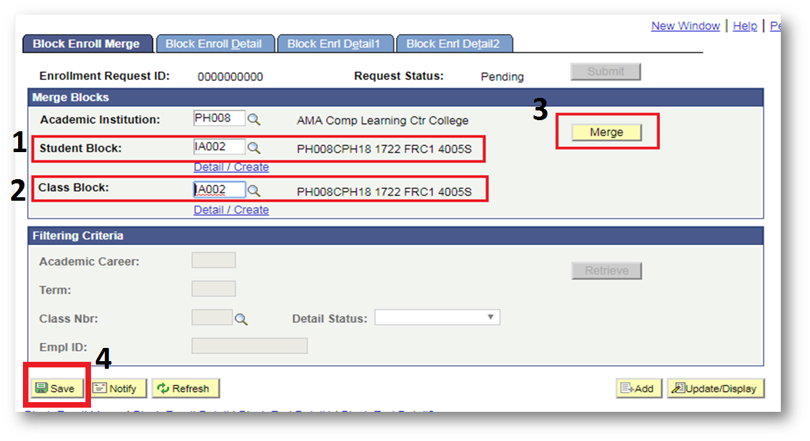
Main menu>> Record & Enrollment >> Enroll Student >> BLOCK ENROLLMENT >> block enroll merge

Slide 44
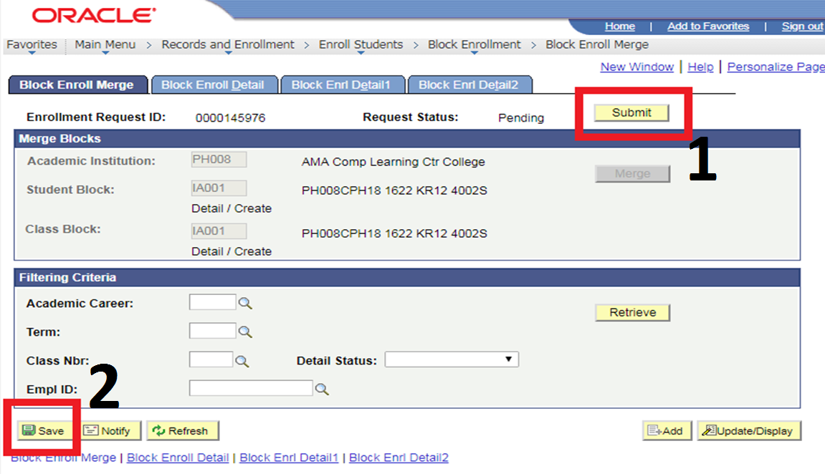

Slide 45
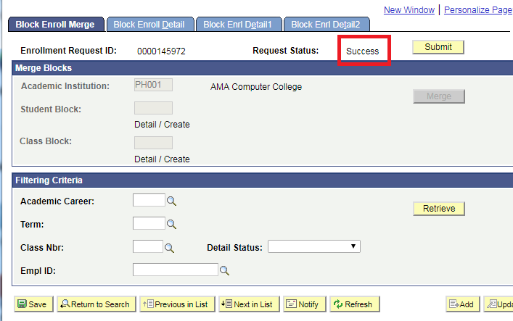

Slide 46
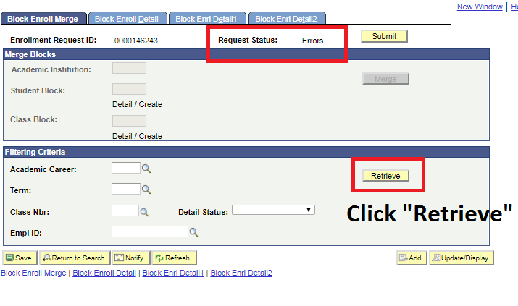
Error:

Slide 47
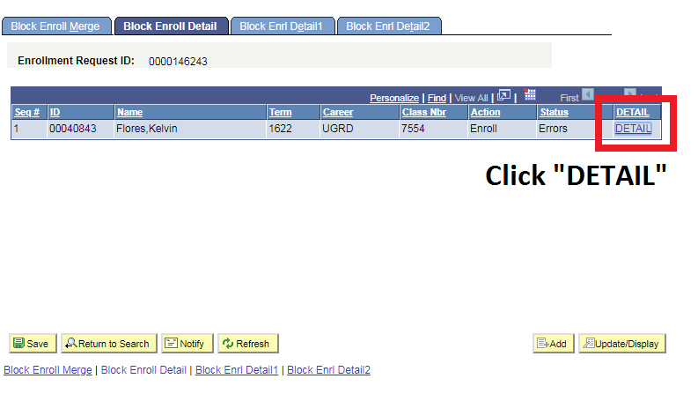

Slide 48
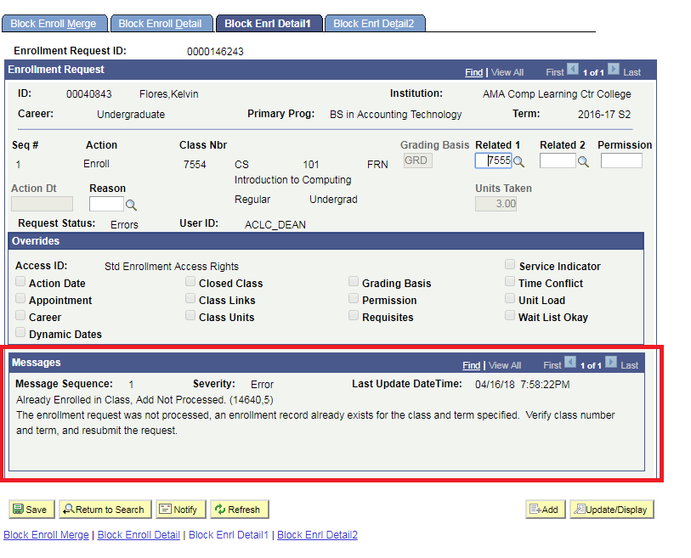
ERROR MESSAGE

Slide 49
CLASS BLOCK (classes)
STUDENT BLOCK
(name student)

Slide 50
REQUEST ADVISEMENT REPORT

Slide 51
Navigation:
Main Menu>> Academic Advisement >> Student Advisement >> Request Advisement Report >> Select Add New Value

Slide 52
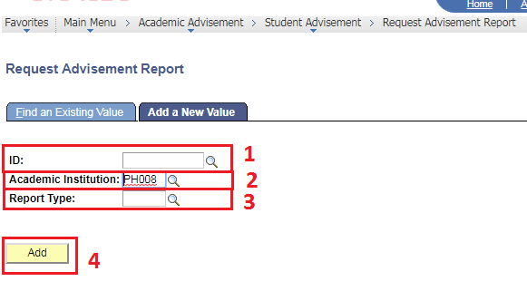
Input USN
Input Academic Institution
Input ADV (Advisement Report)
Click “Add”

Slide 53
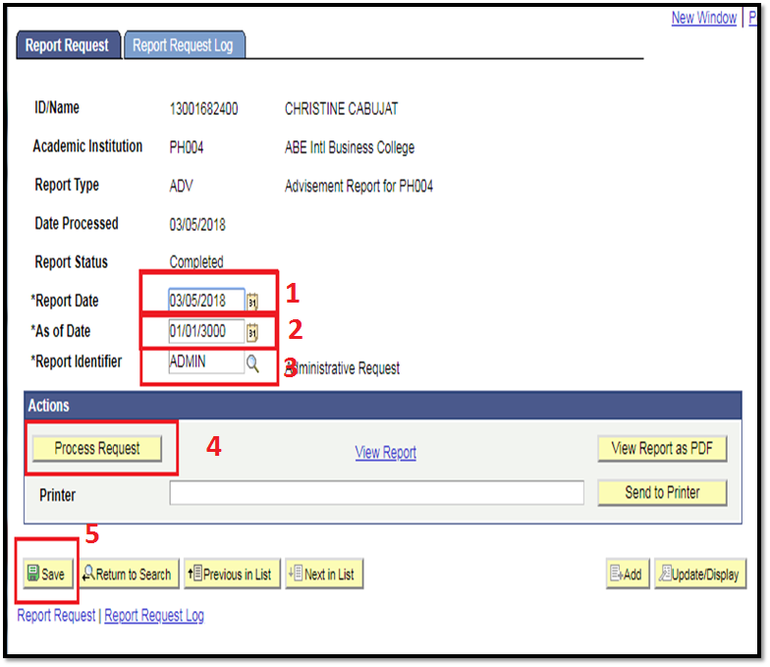

Slide 54
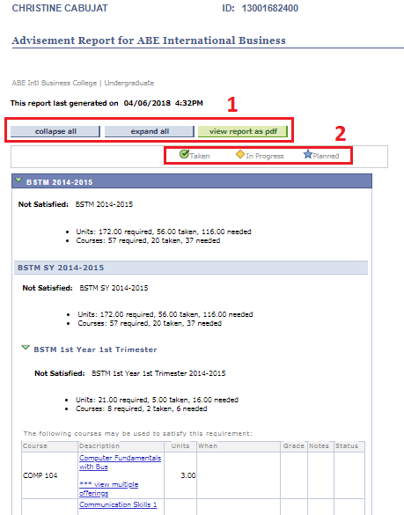
1.
Collapse All – Minimize the result
Expand All – Maximize the result
View Report as PDF – Generate the result to PDF Format
2. Status

Slide 55
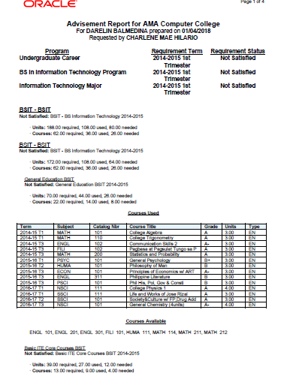
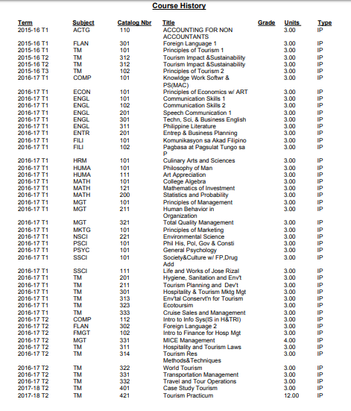
Sample Advisement Report

Slide 56
Thank you
ksflores@amaes.edu.ph
ACADEMIC AFFAIRS DEPT.

